Slide 1
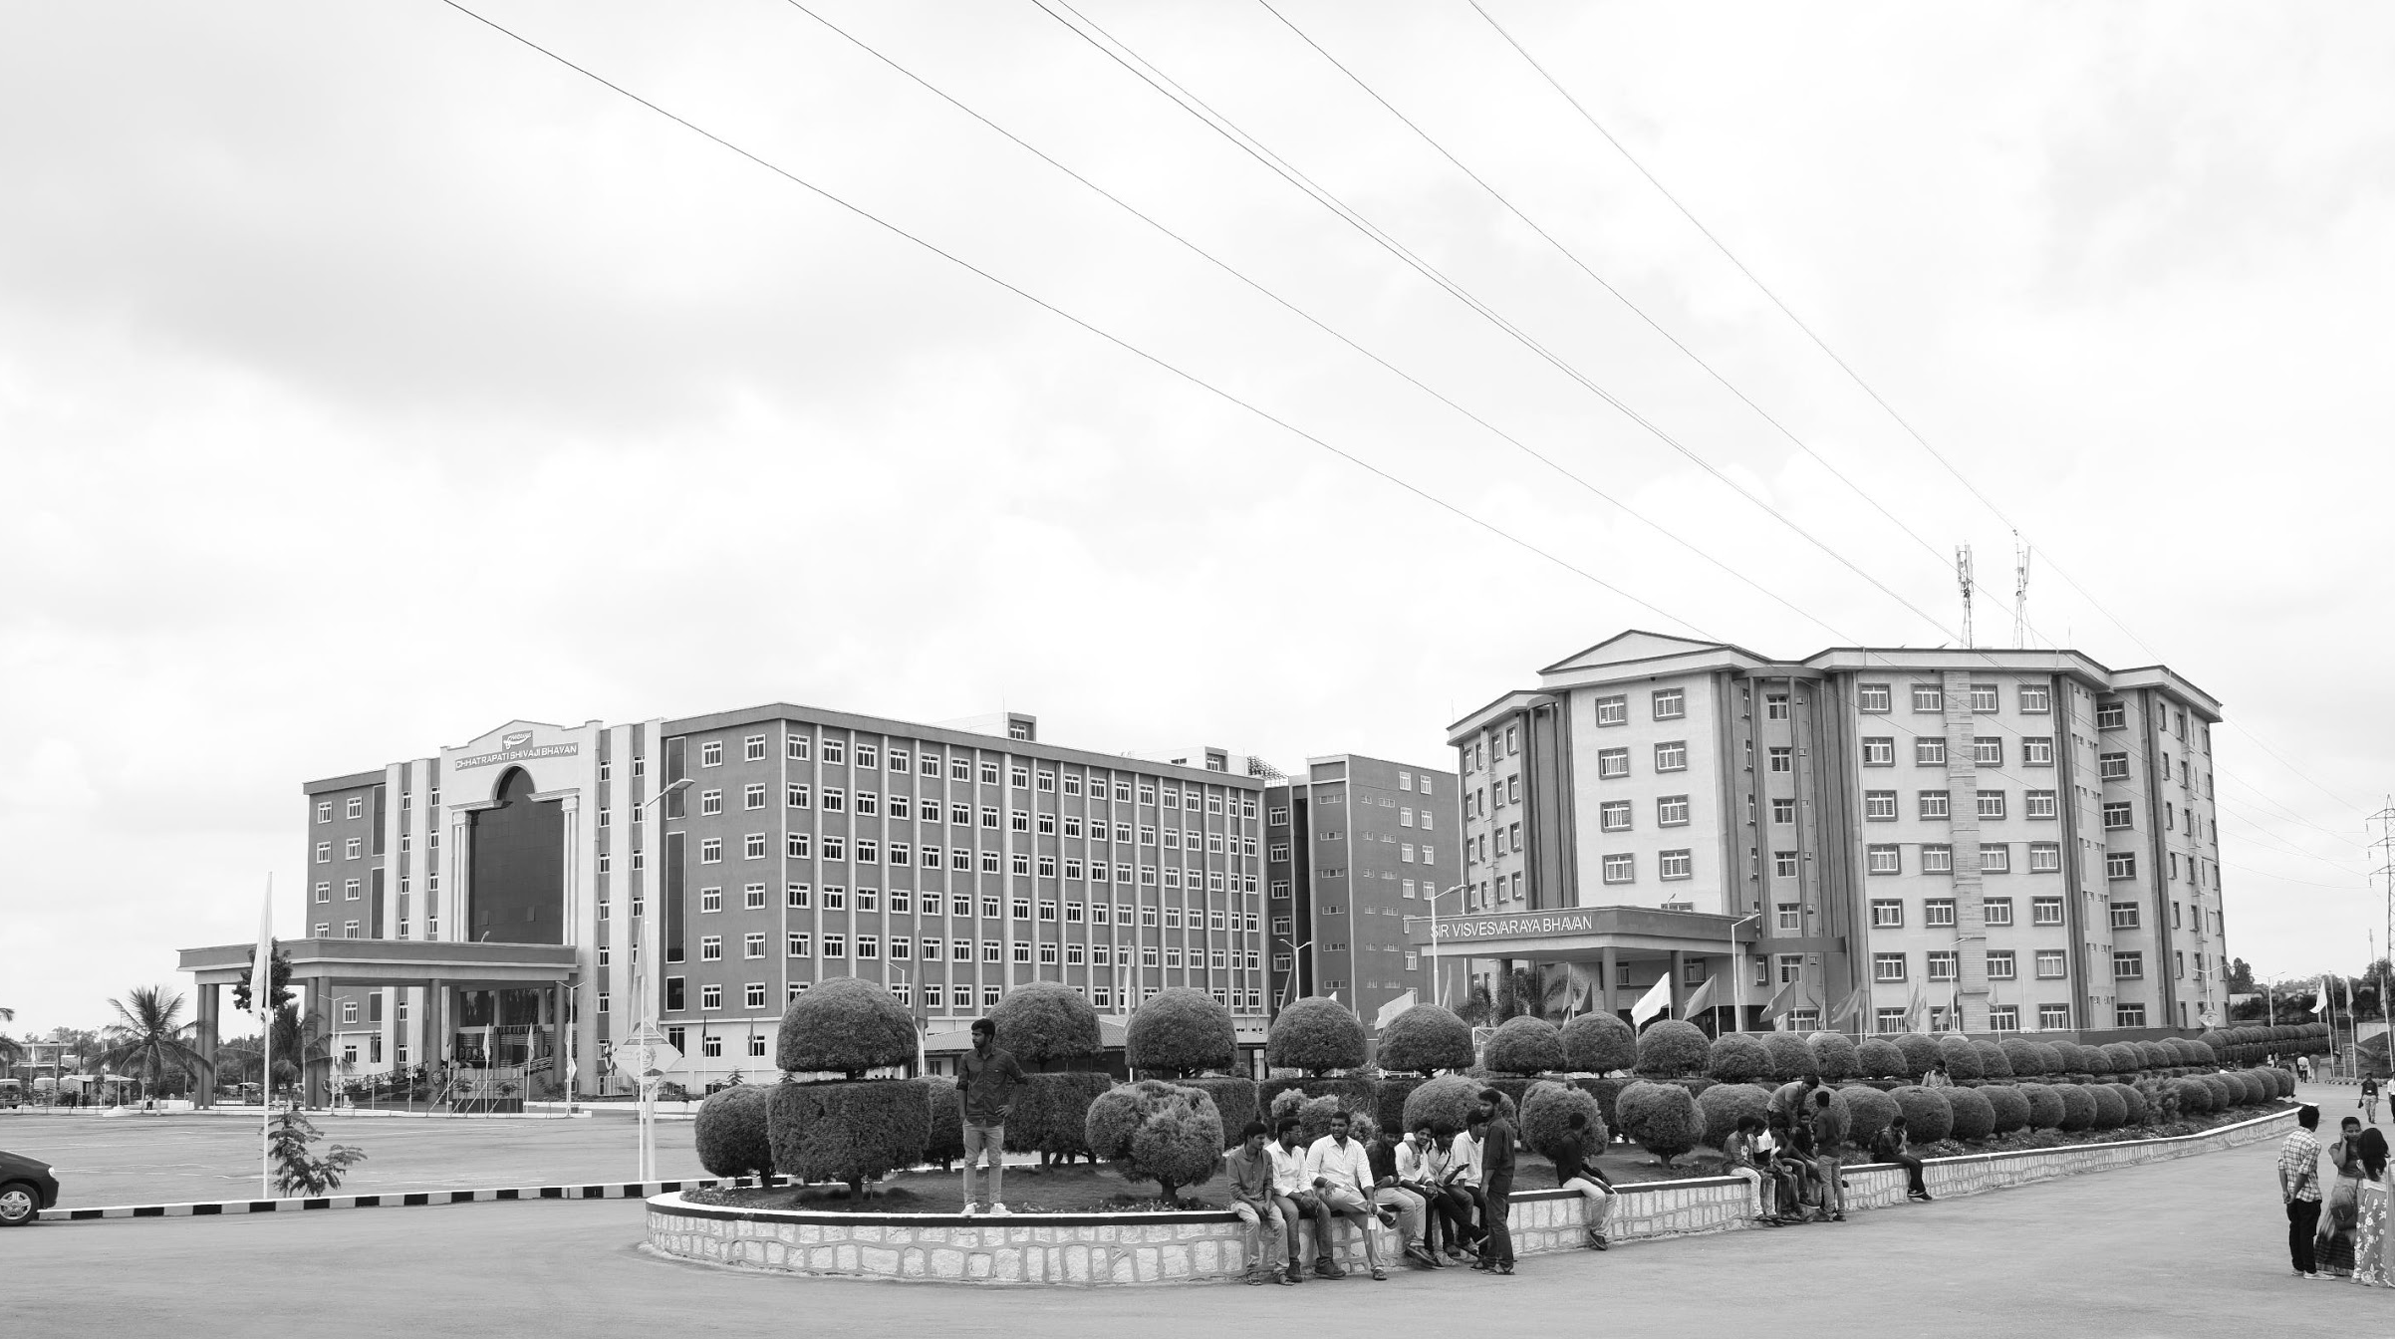

Utilizing ZYNQ 7000 SOC For Automated Plant Disease Detection
AY 2021-25
GITAM UNIVERSITY
Capstone Project
Course Code:PROJ2999
Department of Electrical Electronics and Communication Engineering
Project Team:
BU21EECE0100100 (S.Sameera Tasneem)
BU21EECE0100103 (S.Sai Lohitha)
BU21EECE0100360 (R.Indumathi)
Project Mentor:
Dr. M. Arun Kumar
Associate Professor
www.gitamedu.com

Slide 2

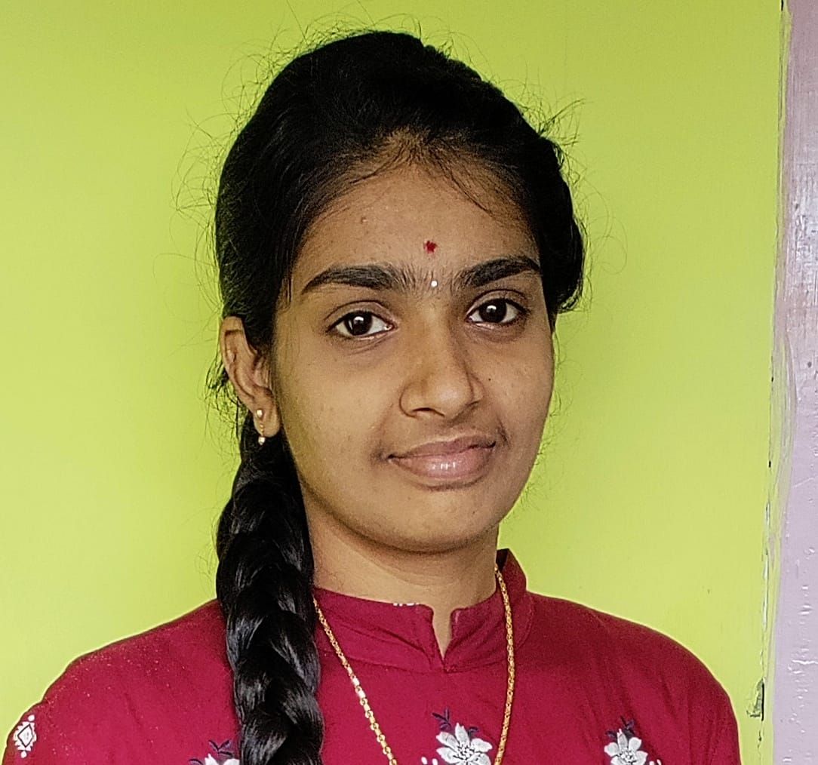
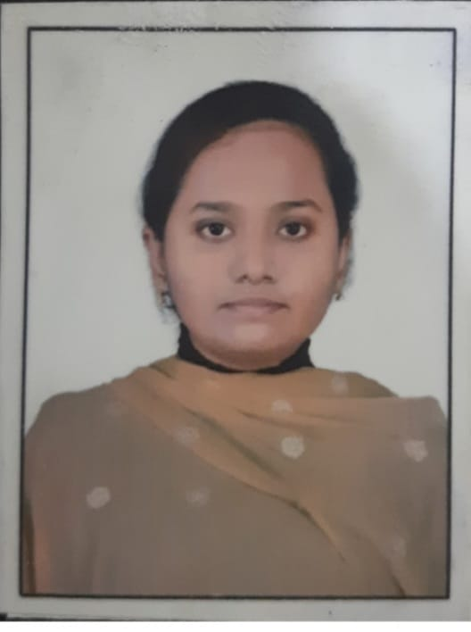
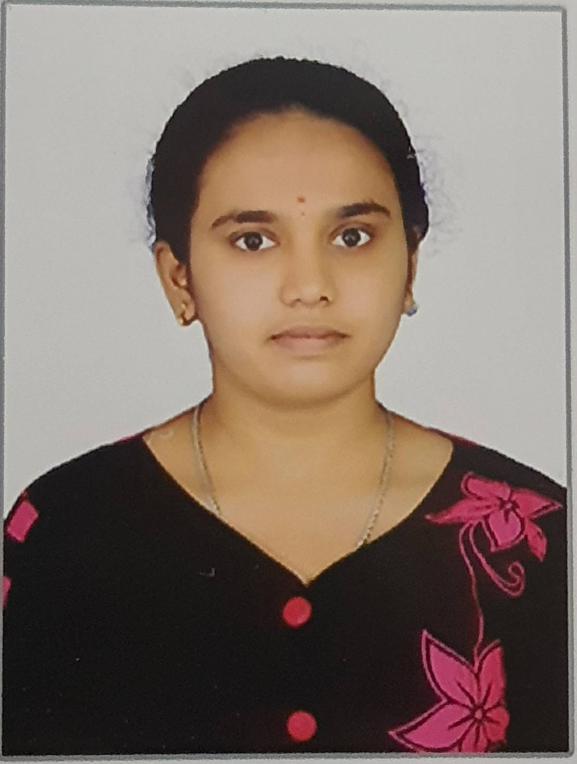
Project Group – Details
Photo
Track
Roll No
Name
EECE
BU21EECE0100360
R.Indumathi
EECE
BU21EECE0100100
S.Sameera Tasneem
EECE
BU21EECE0100103
S.Sai Lohitha

Slide 3
Project Plan
.
Task | Description | Date | Milestone
1. Research Paper Review | Find and review relevant research papers with project guide | 29/07/2024 | Research reviewed
2. Discuss Hardware & Software Tools | Discuss hardware and software tools, and plan project initiation | 31/07/2024 | Tools and initiation planned
3. Verify System in MATLAB | Check the code and verify the system functionality and algorithm in MATLAB | 06/08/2024 – 21/08/2024 | MATLAB verification complete
4. Define System Requirements | Specify hardware and software needs for the ZYNQ 7000 SoC
5. Design Disease Detection Algorithm | Develop AI-based algorithms for plant disease detection

Slide 4
Objective and Goals
Objective
The objective of this project, "Utilizing ZYNQ 7000 SOC for Automatic Plant Disease Detection," is:
To detect potential diseases or stress in plant leaves at an early stage, using ZYNQ 7000 SoC
To provide actionable insights that help farmers optimize the use of water, fertilizers, and other resources, fostering efficient and sustainable farming practices.
To contribute to increased crop yield and quality by promptly addressing leaf-level issues, thereby enhancing overall agricultural productivity for farmers.
Goals
Early Detection of Plant Diseases: Develop a system that can identify potential diseases or stress in plant leaves at an early stage, allowing farmers to intervene before significant damage occurs.
Resource Optimization: Provide farmers with data-driven insights to optimize the use of water, fertilizers, and other agricultural inputs, promoting more efficient and sustainable farming practices.
Enhanced Crop Yield and Quality: Improve overall agricultural productivity by addressing leaf-level issues promptly, leading to higher crop yields and better-quality produce.
User-Friendly Interface: Design an intuitive interface that enables farmers, regardless of their technical expertise, to effectively use the system and benefit from its insights.

Slide 5
ABSTRACT
Plant diseases are a serious threat to agricultural productivity since they can have an impact on crop quality and quantity. Worldwide, millions of tons of crops are lost each year due to various plant diseases, leading to economic losses and food security concerns. Traditional methods for managing plant discases include chemical treatments, crop rotation, and the use of discase resistant crop varieties. However, these measures have limitations, such as environmental impact, the emergence of resistant pathogens, and the time required for developing resistant varieties. To mitigate these losses, a real-time, computer vision-based system for detecting plant illnesses is proposed. This system aims to accurately identify two forms of diseases in plant leaves under various illumination conditions, leveraging the Xilinx ZYNQ SoC FPGA for implementation. The FPGA's low latency performance and parallel processing capabilities make it ideal for real-time applications, enabling rapid processing of high-resolution images and accurate disease detection., thus ensuring timely intervention and minimizing crop loss. The computational complexity and time demand of computer vision applications are addressed by the FPGA's powerful parallel processing and low latency performance. To further enhance the project, edge Al technology will be integrated, allowing the system to process and analyze data directly on devices at the network's edge. This reduces the need for constant connectivity to centralized servers, speeds up reaction times, and increases system resilience and dependability in various field conditions. The FPGA-based real-time plant disease detection system, enhanced by edge AI, offers an accurate and efficient solution to protect agricultural productivity and paves the way for advancements in smart agriculture.
Keywords: Plant diseases, Xilinx ZYNQ SoC FPGA, Crop loss minimization, Edge AI technology, Smart agriculture.

Slide 6
Literature Survey:
The detection of plant diseases is a critical aspect of agricultural management, as early diagnosis can prevent significant crop losses and ensure food security. Various studies have explored the use of image processing and machine learning techniques for automated plant disease detection, focusing on different crops and methods. This literature survey reviews several key studies, highlights their methodologies, and identifies research gaps.
S.NO | Title | Methodology | Significance | Research Gaps | Diseases
1 | Automated Leaf Disease Detection Using ZYNQ FPGA with CNN Acceleration (2023) | Designed a CNN-based leaf disease detection system using the ZYNQ FPGA to accelerate the convolution operations for real-time analysis. | Enhances the accuracy and speed of disease detection while keeping power consumption low, suitable for remote agricultural areas. | Focuses on leaf diseases only, and scalability for multi-crop environments or integration with IoT systems is not addressed. | Cercospora leaf spot, black rot, mosaic virus

Slide 7
2 | Real-Time Image Processing on FPGA for Crop Disease Detection (2022) | The system leverages the ZYNQ SoC to perform real-time image processing for disease detection in crops, employing OpenCV and hardware accelerators. | Highlights the potential for real-time, large-scale deployment in agricultural fields due to the speed of hardware-accelerated image processing techniques on the FPGA. | Lacks the use of advanced AI models for better disease recognition and is not tested on diverse plant species and disease categories. | Anthracnose, fusarium wilt, leaf blight
3 | Implementation of Plant Disease Detection Using Deep Learning on FPGA (2021) | Utilizes ZYNQ 7000 SoC to implement a CNN for plant disease detection. FPGA accelerates inference while the processing system handles control functions. | Demonstrates the efficiency of FPGA-based systems in real-time plant disease detection, reducing latency compared to traditional processing platforms. | Limited to common plant diseases; broader datasets and more advanced neural networks could improve detection accuracy and generalization. | Leaf blight, powdery mildew, bacterial spot

Slide 8
4 | Plant Disease Classification Using Edge AI on ZYNQ SoC (2020) | Deployed a machine learning model on ZYNQ SoC using edge AI techniques. The focus was on classifying diseases from plant leaf images. | Provides a low-power, high-performance solution for real-time classification of plant diseases at the edge, minimizing the need for cloud computation. | Does not explore more complex plant diseases requiring multi-modal inputs (e.g., climate, soil data) to enhance decision-making. | Late blight, early blight, leaf curl virus
5 | FPGA-Based Smart Agriculture System for Plant Disease Monitoring (2019) | Developed an FPGA-based system using ZYNQ 7000 for real-time monitoring and early detection of plant diseases through image analysis and sensor data. | Combines image processing and environmental sensors to create a more comprehensive disease detection system, offering scalability and faster response times in the field. | Lack of integration with deep learning algorithms; relies on simpler image processing techniques which may limit accuracy for more challenging plant diseases. | Rust, downy mildew, leaf spot

Slide 9
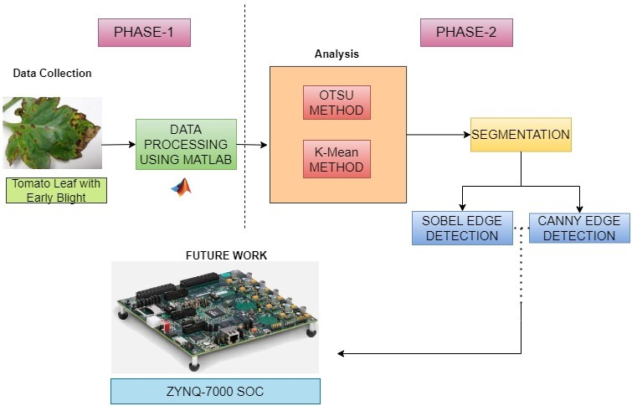
BLOCK DIAGRAM

Slide 10
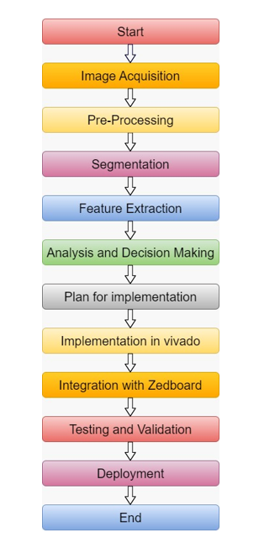
Workflow Of Proposed System

Slide 11
Automated Detection of Diseased Plant Leaves Using MATLAB
Image Processing Toolbox: MATLAB provides easy-to-use functions for tasks like thresholding, segmentation, and edge detection, making it ideal for image analysis.
Fast Prototyping: MATLAB allows you to quickly write and test code for image processing without needing to manage complex low-level operations.
Built-in Visualization: It has built-in tools for displaying and comparing images, making it easy to see results instantly.
Efficient Matrix Operations: MATLAB is optimized for handling matrices, which is essential for fast image manipulation and processing.
Support and Documentation: With a large community and well-documented resources, troubleshooting and learning in MATLAB is straightforward.

Slide 12
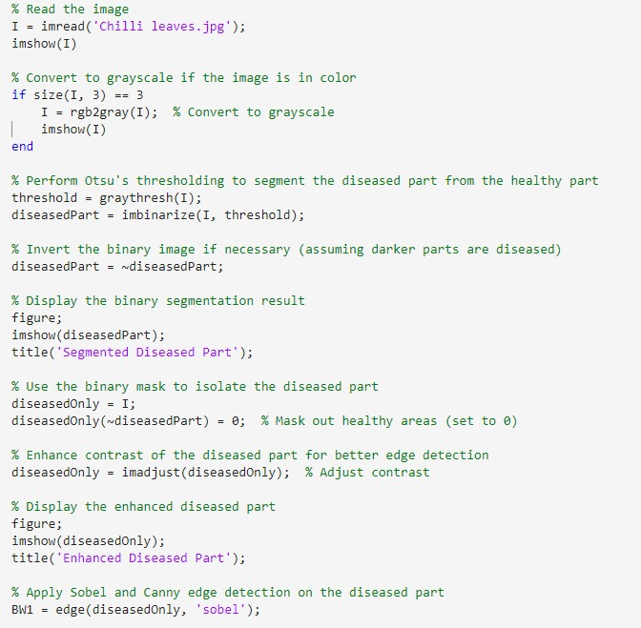
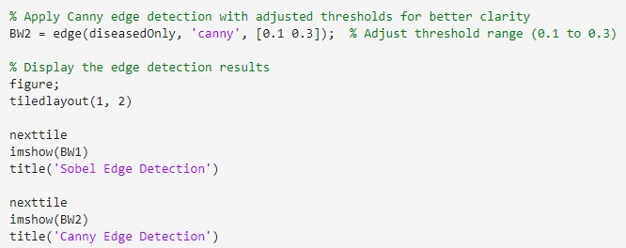
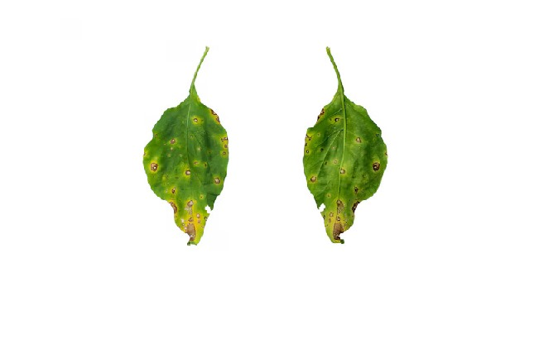
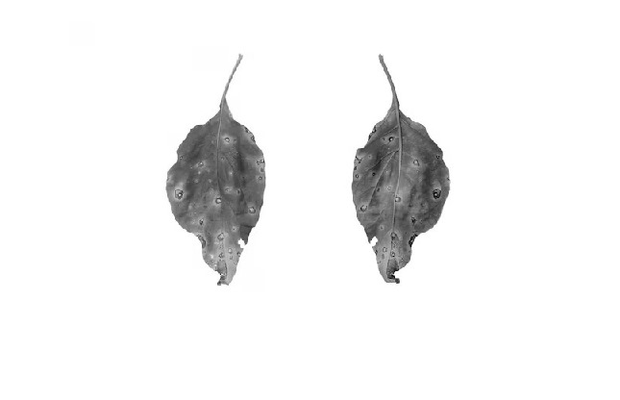
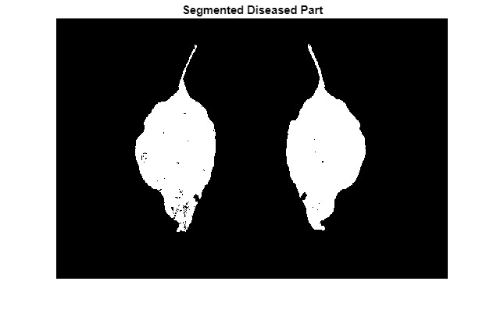
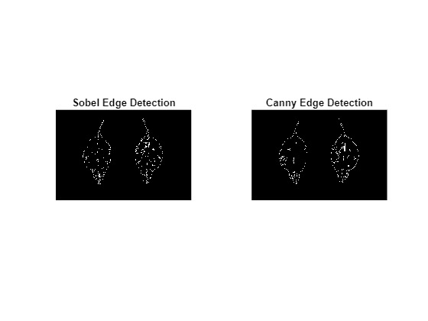
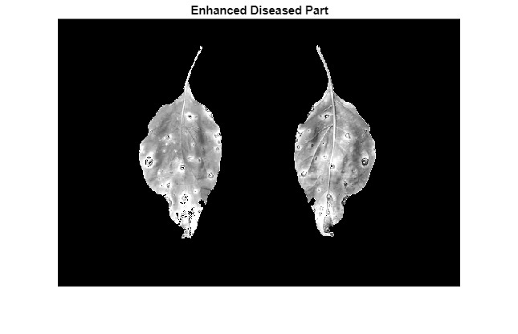
MATLAB CODE FOR LEAF DISEASE DETECTION
12

Slide 13
CODE EXPLANATION
Read and Show the Image: The code loads an image of chili leaves (Chilli leaves.jpg) and shows it on the screen.
Convert to Grayscale: If the image is in color, it changes the image to black and white (grayscale).
Segment Diseased Parts: The code automatically finds a threshold to separate the diseased parts of the leaf from the healthy parts using Otsu's method. It creates a binary image (black and white) where the diseased parts are marked.
Isolate the Diseased Areas: It removes the healthy areas from the image so only the diseased parts are visible. The contrast of the diseased part is increased to make the features more noticeable.
Detect Edges: Two different edge detection techniques are applied to the diseased areas: Sobel and Canny. Sobel detects basic edges, and Canny does more precise edge detection.
Show Results: Finally, the code displays two side-by-side images, one for Sobel edge detection and one for Canny edge detection, so you can compare the results.

Slide 14
KEYWORDS:
imread: Loads an image from a file into MATLAB.
imshow: Displays an image in a figure window.
rgb2gray: Converts a color image to grayscale.
size: Returns the dimensions of an array or image.
graythresh: Computes a threshold for image segmentation using Otsu's method.
imbinarize: Converts a grayscale image to a binary (black-and-white) image based on a threshold.

Slide 15
Common Chilli Leaf Diseases
1.Powdery Mildew
Symptoms: White, powdery fungal growth.
Weather: High humidity, warm temperatures.
Prevention: Improve air circulation, avoid overhead watering, use fungicides.
2. Leaf Curl Virus
Symptoms: Curled, brittle leaves with yellowing.
Weather: High temperatures, high humidity.
Prevention: Use resistant varieties, control aphids, remove infected plants.
3. Bacterial Leaf Spot
Symptoms: Dark spots with yellow halos.
Weather: Wet, rainy conditions.
Prevention: Avoid overhead irrigation, improve air circulation, use bactericides.
4. Early Blight
Symptoms: Dark spots with concentric rings on leaves.
Weather: Warm, moist conditions.
Prevention: Remove affected parts, use fungicides, ensure proper plant spacing.
5. Fusarium Wilt
Symptoms: Yellowing and wilting of leaves.
Weather: High temperatures, poor soil drainage.
Prevention: Improve drainage, rotate crops, use resistant varieties.

Slide 16
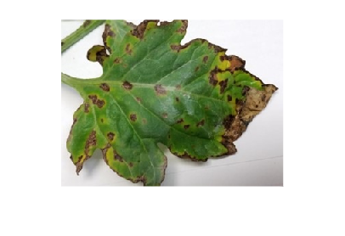
Common Tomato Leaf Diseases
1. Early Blight
Symptoms: Dark spots with concentric rings on older leaves.
Weather: Warm, moist conditions.
Prevention: Remove affected leaves, use fungicides, space plants properly.
2. Late Blight
Symptoms: Irregular brown spots with white mold on the underside.
Weather: Cool, wet conditions.
Prevention: Avoid overhead watering, use resistant varieties, apply fungicides.
3. Leaf Curl Virus
Symptoms: Curled, brittle leaves with stunted growth.
Weather: High temperatures, high humidity.
Prevention: Use resistant varieties, control aphids, remove infected plants.
4. Bacterial Spot
Symptoms: Small, dark, sunken spots with yellow halos.
Weather: Warm, humid conditions.
Prevention: Improve air circulation, avoid wetting foliage, use bactericides.
5. Fusarium Wilt
Symptoms: Yellowing and wilting of leaves, starting from the bottom.
Weather: High temperatures, poor soil drainage.
Prevention: Enhance soil drainage, rotate crops, use resistant varieties.

Slide 17
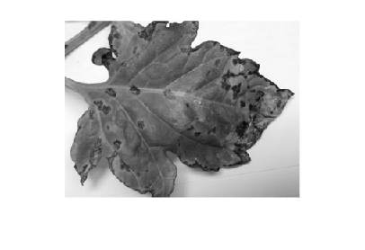
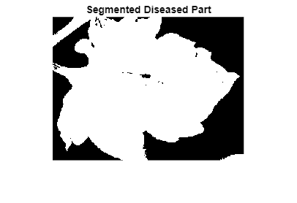
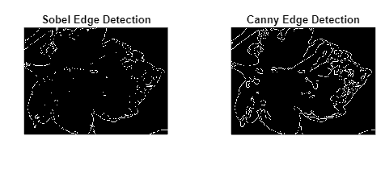
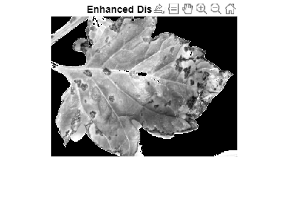

Slide 18
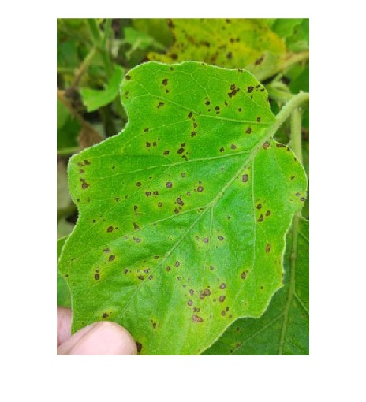
Common Eggplant Leaf Diseases
1. Fusarium Wilt
Symptoms: Yellowing and wilting of leaves, often starting from the bottom.
Weather: High temperatures, poor soil drainage.
Prevention: Improve soil drainage, rotate crops, use resistant varieties.
2. Powdery Mildew
Symptoms: White, powdery fungal growth on leaves and stems.
Weather: High humidity, warm temperatures.
Prevention: Ensure good air circulation, avoid overhead watering, use fungicides.
3. Bacterial Spot
Symptoms: Small, dark spots with yellow halos.
Weather: Warm, humid conditions.
Prevention: Improve air circulation, avoid wetting foliage, use bactericides.
4. Leaf Curl Virus
Symptoms: Curled, brittle leaves with stunted growth.
Weather: High temperatures, high humidity.
Prevention: Use resistant varieties, control aphids, remove infected plants.
5. Early Blight
Symptoms: Dark spots with concentric rings on older leaves.
Weather: Warm, moist conditions.
Prevention: Remove affected leaves, use fungicides, space plants properly.

Slide 19
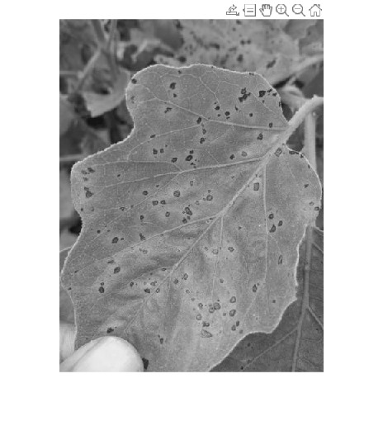
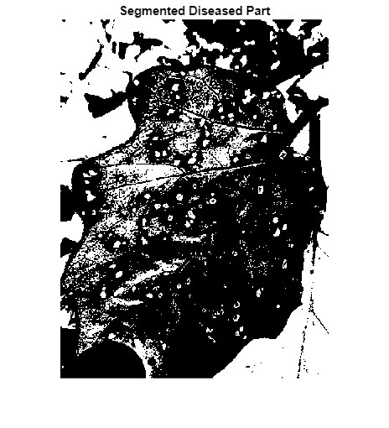
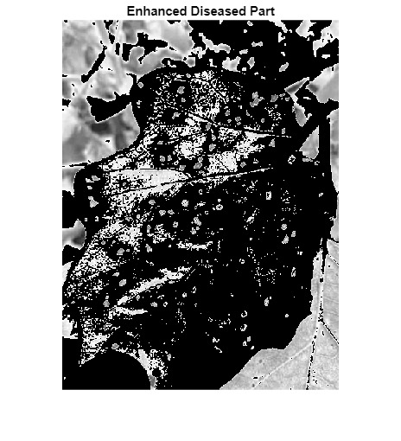
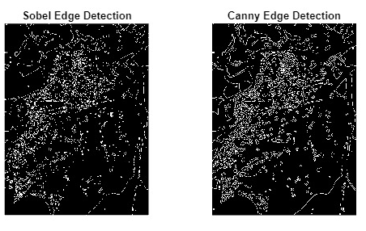

Slide 20
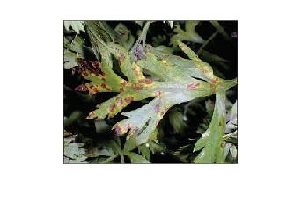
Common Carrot Leaf Diseases
1.Carrot Rust Fly
Symptoms: Wilting and browning of leaves, with larvae causing damage underground. Weather: Warm, moist conditions.
Prevention: Use floating row covers, practice crop rotation, and remove debris.
2. Alternaria Leaf Blight
Symptoms: Dark, sunken spots with concentric rings on leaves.
Weather: Warm, humid conditions.
Prevention: Avoid overhead watering, space plants well, use fungicides if needed.
3. Powdery Mildew
Symptoms: White, powdery fungal growth on leaves.
Weather: High humidity, warm temperatures.
Prevention: Improve air circulation, avoid overhead watering, use fungicides.
4. Downy Mildew
Symptoms: Yellow patches on leaves with a grayish mold on the underside.
Weather: Cool, damp conditions.
Prevention: Ensure good air circulation, avoid excessive moisture, use resistant varieties.
5. Leaf Blight
Symptoms: Irregular, dark spots on leaves that can lead to leaf death.
Weather: Warm, wet conditions.
Prevention: Remove affected leaves, improve plant spacing, use fungicides.

Slide 21
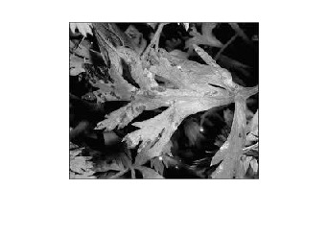
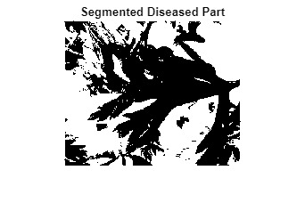
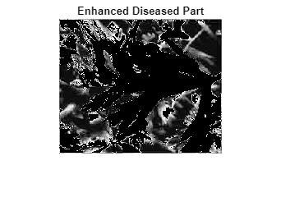
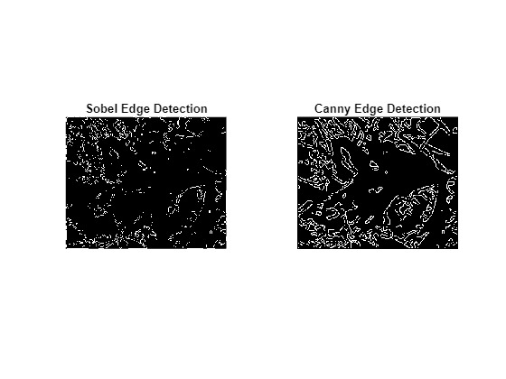

Slide 22
Analysis - SWOT
Weaknesses
Strengths
Complexity: Demands expertise in both hardware and software.
Cost: Higher initial expense than simpler processors.
Power Consumption: Potentially higher than low-power alternatives.
Limited Software Ecosystem: Fewer tools and libraries, increasing development time.
High Performance: ARM processors and FPGA offer powerful processing.
Real-time Processing: FPGA supports quick disease detection.
Customizability: Custom logic can be designed for specific needs.
Low Latency: FPGA reduces processing delays.
Threats
Opportunities
Advancements in AI: Enhances detection capabilities with advanced algorithms.
Scalability: Adapts to different crops and environments.
IoT Integration: Enables comprehensive agricultural monitoring.
Cost Reduction Over Time: Technology costs may decrease, increasing accessibility.
Technological Obsolescence: Advancements may outdate current solutions.
Competitive Market: Competitors may offer more advanced or cost-effective alternatives.
Dependency on Hardware: Reliance on specific components poses risks of obsolescence.
Regulatory and Compliance Issues: Agricultural regulations and data privacy may create deployment challenges.

Slide 23
Review Phase-2
Analysis – 4W1H for Plant Disease Detection Using ZYNQ 7000 SoC
Why:
The purpose of this project is to help farmers detect plant diseases early, so they can take action before the diseases spread and damage the crops. This will improve crop health and increase productivity in agriculture.
What:
We are building a system that can automatically identify diseases in plant leaves using advanced image processing techniques. In the first stage, we're using MATLAB to process images and detect diseased areas using methods like K-means clustering and Otsu's thresholding. Later, we’ll move the system to the ZYNQ 7000 SoC hardware for real-time performance in the field.
Where:
The initial phase of the project is done in MATLAB, where we are analyzing plant leaf images to find disease patterns. Once we have the methods working well, the system will be deployed on the ZYNQ 7000 SoC hardware, which can be placed on farms to monitor plant health in real-time.

Slide 24
When:
Currently, we are in the image processing stage using MATLAB. After fine-tuning the detection methods, we’ll begin implementing them on the ZYNQ 7000 SoC hardware for real-time use in the next phase. This will allow us to monitor crops in real-time on farms.
How:
The project starts by taking images of plant leaves. Then, the images are enhanced, and we use techniques like K-means clustering and Otsu’s method to identify diseased areas. After that, we perform edge detection using Sobel and Canny filters to outline the diseased parts. Statistics about the diseased areas are also collected. Once the image processing is optimized, the algorithms will be moved to the ZYNQ 7000 SoC to run on hardware, making the system faster and more efficient for real-time use in the field.
Refined Objective:
To create an easy-to-use, real-time plant disease detection system that can help farmers quickly identify and manage crop diseases. The system will start with image processing techniques in MATLAB and later be moved to the ZYNQ 7000 SoC hardware for practical use in the field, ensuring better crop management and healthier plants.

Slide 25
Code 1 (Otsu's Method):
Purpose: This is used for image thresholding—essentially deciding the best way to split the image into two parts: foreground (important part) and background (the rest).
Focus: Otsu’s method tries to find the optimal threshold value that separates the image into these two areas by minimizing the variance within each region.
Key Operations:
It converts the image to grayscale and calculates a threshold automatically.
Thresholding means turning the image into a binary image, where pixels are either black or white based on that threshold.
It’s super useful for separating objects from their background.
Code 2 (K-Means Clustering):
Purpose: This code is also for segmentation, but it uses k-means clustering to divide the image into two or more parts (clusters) based on colour or intensity.
Focus: It groups similar pixels together based on their colour intensity (like diseased vs healthy parts).
Key Operations:
It uses the k-means algorithm to group the pixels into clusters based on their values.
The result is an image where pixels are assigned to different clusters.

Slide 26

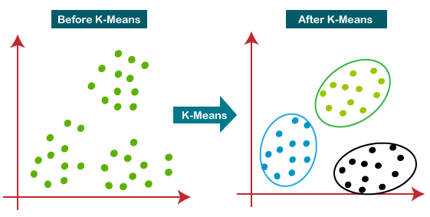
Use Cases & Testing
1. Image Capture
Objective: Capture high-resolution images of plant leaves.
Input: Real-time image from cameras/sensors.
Outcome: Clear, focused image for processing.
Flow: Power on → Capture image → Save.
Preconditions: Proper sensor setup.
Postconditions: Image saved for processing.
2. Image Preprocessing
Objective: Enhance image quality by removing noise.
Input: Raw leaf image.
Outcome: Preprocessed image ready for segmentation.
Flow: Load image → Apply noise removal → Enhance contrast.
Preconditions: Image available.
Postconditions: Clear image for next steps.
3. K-means Disease Detection
Objective: Segment diseased parts using K-means.
Input: Preprocessed image.
Outcome: Binary mask of diseased area.
Flow: Load image → Apply K-means → Generate mask.
Preconditions: Preprocessed image ready.
Postconditions: Segmented diseased areas.

Slide 27
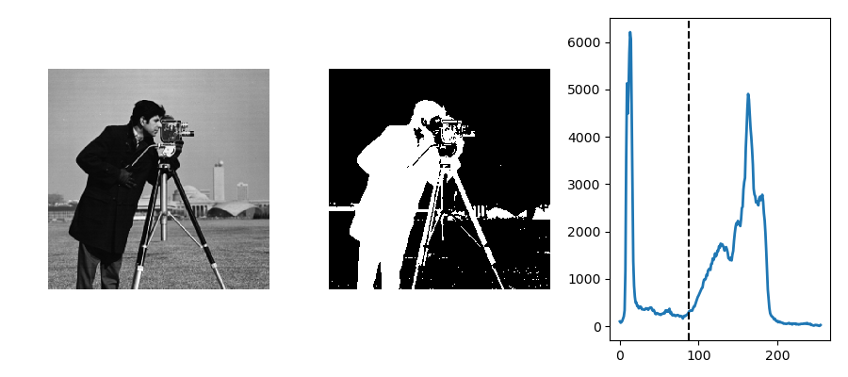
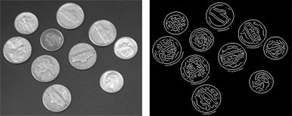
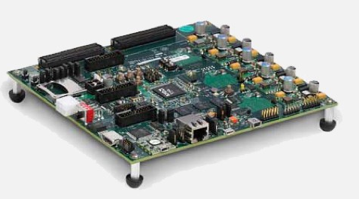
4. Otsu’s Disease Detection
Objective: Detect disease using Otsu's method.
Input: Pre-processed image.
Outcome: Binary mask of diseased regions.
Flow: Load image → Apply Otsu’s threshold → Generate mask.
Preconditions: Image prepared for thresholding.
Postconditions: Segmented diseased areas.
5. Edge Detection
Objective: Detect edges of leaf and diseased areas.
Input: Preprocessed image.
Outcome: Edges highlighted for analysis.
Flow: Apply Sobel/Canny edge detection → Display.
Preconditions: Image ready.
Postconditions: Leaf and disease edges identified.
6. ZYNQ 7000 Integration
Objective: Implement real-time processing on ZYNQ 7000.
Input: MATLAB code.
Outcome: Optimized disease detection on hardware.
Flow: Transfer code to Vivado → Test real-time processing.
Preconditions: MATLAB code prepared.
Postconditions: Real-time detection running on ZYNQ SoC.

Slide 28
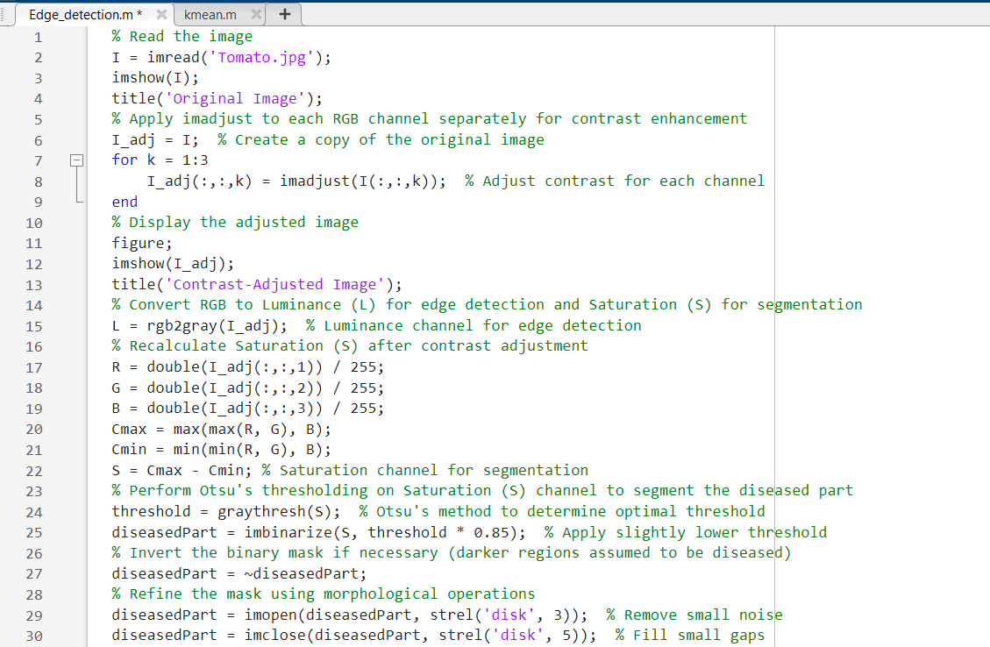
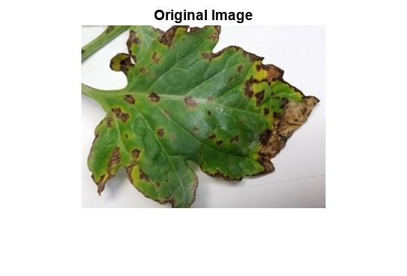

MATLAB CODE FOR LEAF DISEASE DETECTION USING OTSU METHOD
a)Original image of Tomato leaf with Leaf Blight disease
b)Contrast-adjusted image of original image

Slide 29
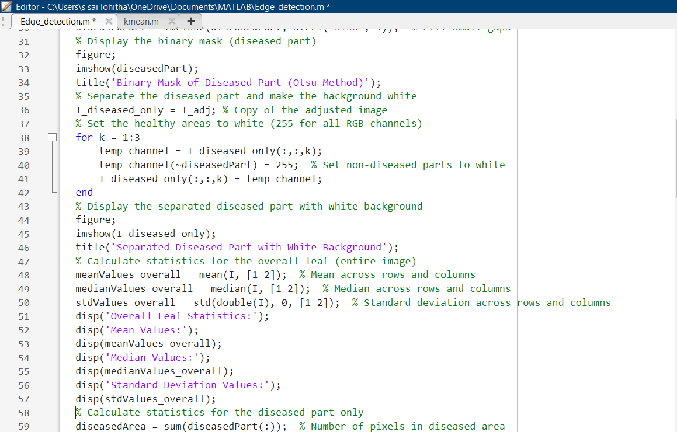
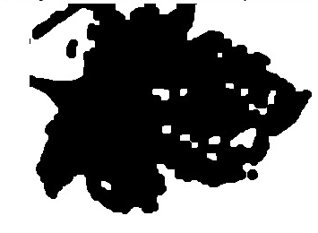
c)Binary-mask of diseased part using Otsu’s method

Slide 30
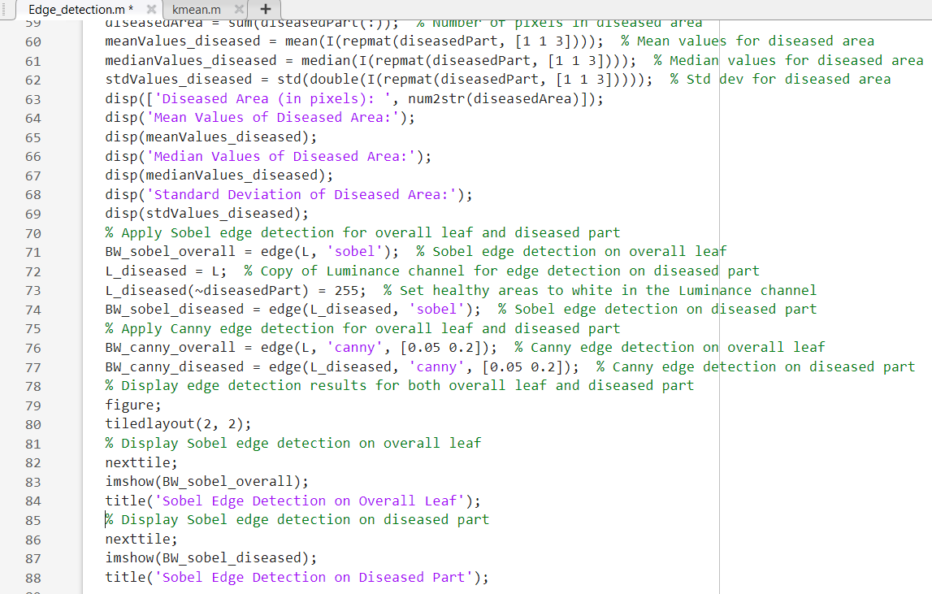
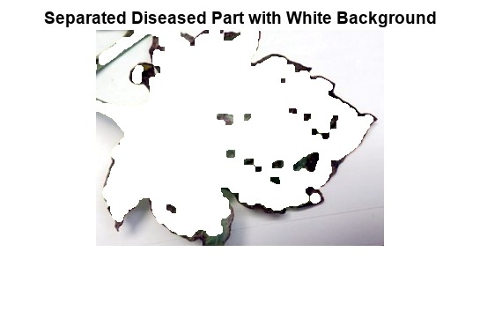
d)Separated diseased part with white background

Slide 31
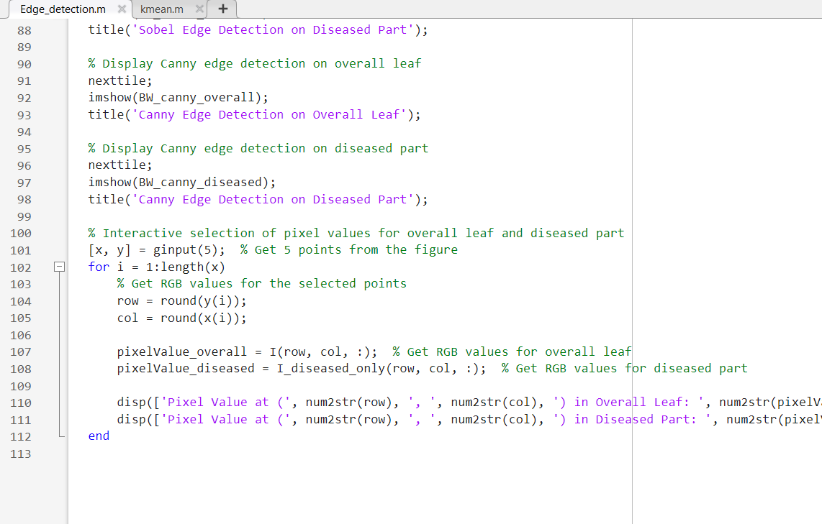
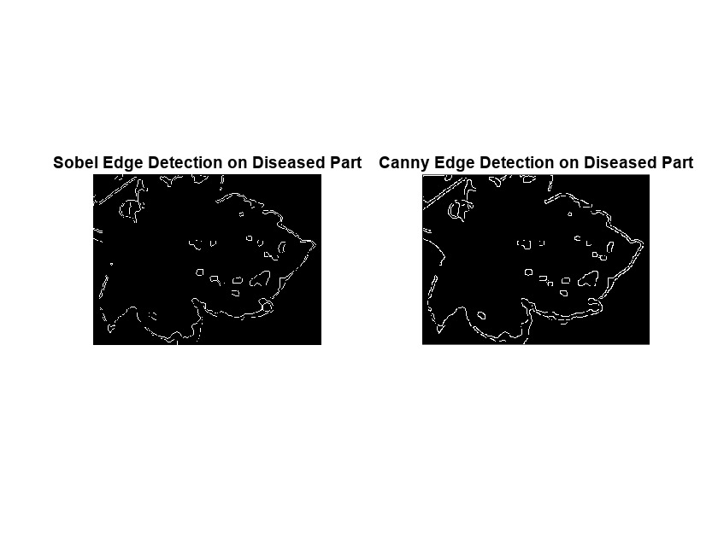
e)Sobel edge detection on diseased part
f)Canny edge detection on diseased part

Slide 32
CODE EXPLANATION
Image Loading:
imread: Reads the image file (Tomato.jpg).
imshow: Displays the original image.
Contrast Enhancement:
imadjust: Adjusts the contrast of each RGB channel separately for better visibility of features.
The loop (for k = 1:3) iterates through each color channel (R, G, B) to enhance contrast.
Keyword: Contrast Enhancement.
Convert to Grayscale and Compute Saturation:
rgb2gray: Converts the contrast-adjusted image to grayscale for edge detection (L channel).
Saturation (S) is recalculated using the formula S = Cmax - Cmin after adjusting the contrast.
Keyword: Grayscale, Saturation Calculation.
Otsu's Method for Segmentation:
graythresh: Uses Otsu's method to determine an optimal threshold for segmenting the diseased parts.
imbinarize: Binarizes the saturation channel based on the threshold, creating a binary mask (diseased Part).
Morphological operations (imopen, imclose) are applied to refine the binary mask.
Keywords: Otsu's Thresholding, Morphological Operations.

Slide 33
5.Isolate Diseased Area:
repmat: Replicates the binary mask to apply across all RGB channels.
Non-diseased areas are set to white (255) in the RGB image (I_diseased_only), isolating the diseased parts.
Keywords: Diseased Part Isolation, Binary Mask Application.
6.Statistical Calculations:
mean, median, std: Calculate mean, median, and standard deviation for both the overall leaf and the diseased part.
Keywords: Mean, Median, Standard Deviation, Diseased Area Statistics.
7.Edge Detection (Sobel and Canny):
edge: Applies Sobel and Canny edge detection to both the overall leaf and the isolated diseased part.
Sobel and Canny edges are computed on the grayscale (L) channel and the isolated diseased luminance channel (L_diseased).
Keywords: Sobel Edge Detection, Canny Edge Detection.
8.Visualization:
tiledlayout: Creates a grid layout for displaying multiple images.
The results of Sobel and Canny edge detection are shown side-by-side for both overall and diseased parts.
Keyword: Visualization.
9.Interactive Pixel Value Selection:
ginput: Allows the user to click on points in the figure to get RGB pixel values from the original image and the isolated diseased part.
The selected points' pixel values are displayed in the command window.
Keywords: Interactive Selection, Pixel Values, ginput.

Slide 34
KEYWORDS
Keywords Summary:
Image Loading: imread, imshow.
Contrast Enhancement: imadjust, RGB Channels.
Grayscale Conversion: rgb2gray.
Saturation Calculation: Cmax, Cmin.
Otsu's Thresholding: graythresh, imbinarize.
Morphological Operations: imopen, imclose.
Isolate Diseased Part: Binary Mask, repmat.
Statistical Calculations: mean, median, std.
Edge Detection: edge, Sobel, Canny.
Visualization: tiledlayout.
Interactive Selection: ginput, Pixel Values.

Slide 35
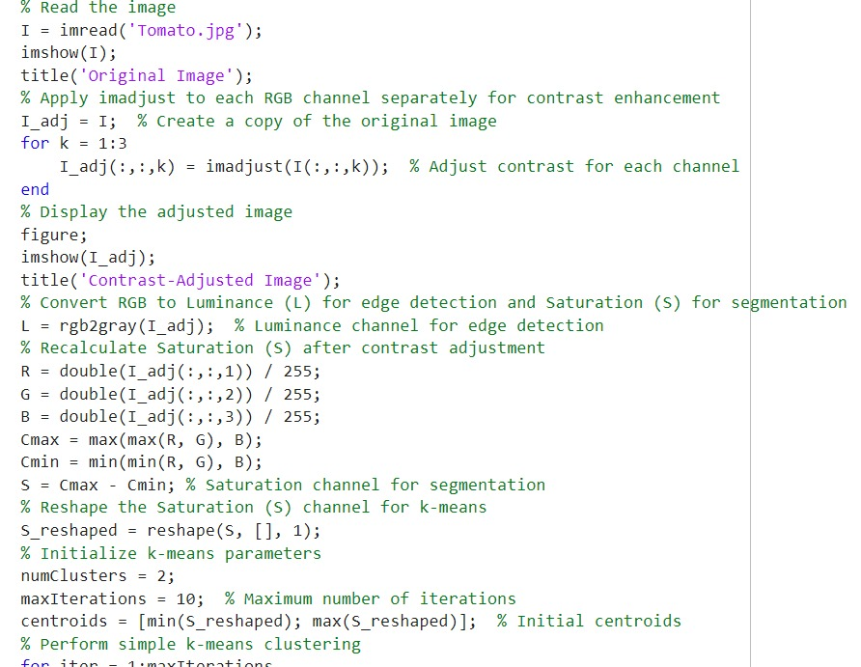

MATLAB CODE FOR LEAF DISEASE DETECTION USING K-MEANS METHOD
a)Original image of Tomato leaf with Leaf Blight disease
b)Contrast-adjusted image of original image

Slide 36
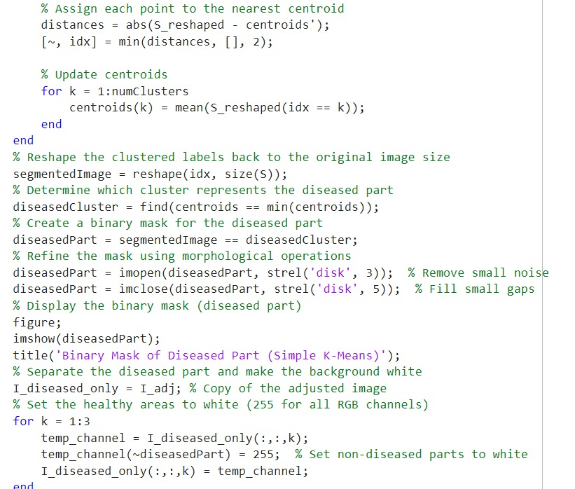
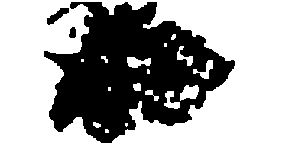
c)Binary-mask of diseased part using K-Mean method

Slide 37
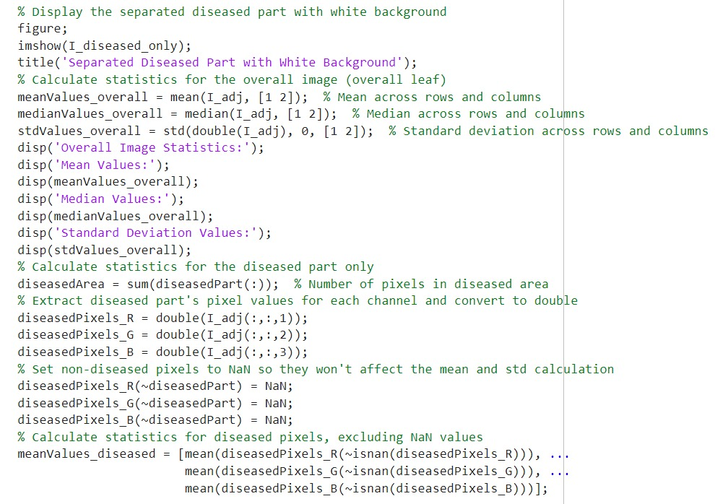
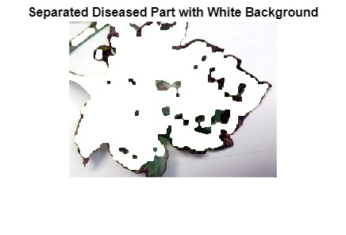
d)Separated diseased part with white background

Slide 38
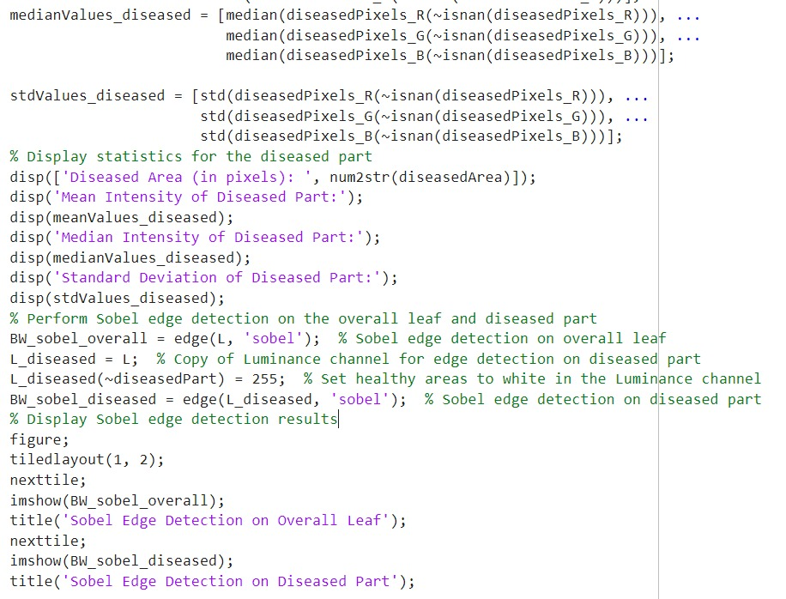
e)Sobel edge detection on diseased part
f)Canny edge detection on diseased part

Slide 39
CODE EXPLANATION
Image Reading and Display: The image "Tomato.jpg" is loaded and displayed using imread() and imshow().
Contrast Enhancement: imadjust() is applied to each RGB channel individually to enhance contrast.
Luminance and Saturation Calculation: The RGB image is converted to Luminance (L) for edge detection and Saturation (S) for image segmentation. rgb2gray() is used for converting RGB to grayscale, while the saturation is calculated based on the difference between the max and min RGB channel values.
K-Means Clustering: K-means clustering with two clusters is applied to the reshaped Saturation values (S_reshaped) to segment the image. The disease-affected area is identified by finding the cluster with the lowest centroid.
Morphological Operations: The binary mask representing the diseased part is refined using imopen() and imclose() to remove noise and fill gaps.
6.Separation of Diseased Part: The diseased area is separated from the healthy part by setting the healthy areas of the image to white.
7.Statistical Analysis: Statistics like mean, median, and standard deviation are calculated for both the overall image and the diseased part. Non-diseased pixels are excluded from the analysis using NaN values.
8.Sobel Edge Detection: Sobel edge detection is performed on the overall image and the diseased part to highlight edges, using the edge() function.

Slide 40
KEYWORDS
imread(): Reads the image file into MATLAB as an array, storing pixel values.
imshow(): Displays the image on a figure window.
imadjust(): Enhances the contrast of an image by adjusting the intensity values. It is applied to individual RGB channels in this code.
rgb2gray(): Converts an RGB image to a grayscale image, representing the luminance (brightness) of the image.
reshape(): Reshapes a matrix into a new size. Here, it reshapes the Saturation channel into a vector to apply k-means clustering.
6.Morphological Operations:
imopen(): Performs erosion followed by dilation, which helps remove small noise in binary images.
imclose(): Performs dilation followed by erosion, which fills small holes or gaps in binary images.
7.Standard Deviation (std()): Measures how spread out the pixel values are from the mean, indicating the contrast variability.
8.Sobel Edge Detection (edge()): A method to detect edges in an image by highlighting areas with rapid intensity changes. Here, it is applied to both the overall image and the diseased part to detect boundaries.

Slide 41
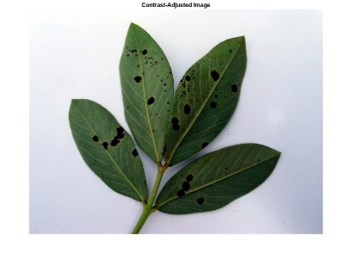
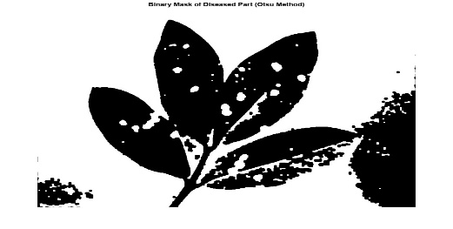
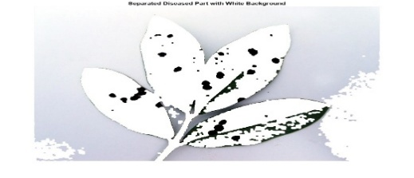
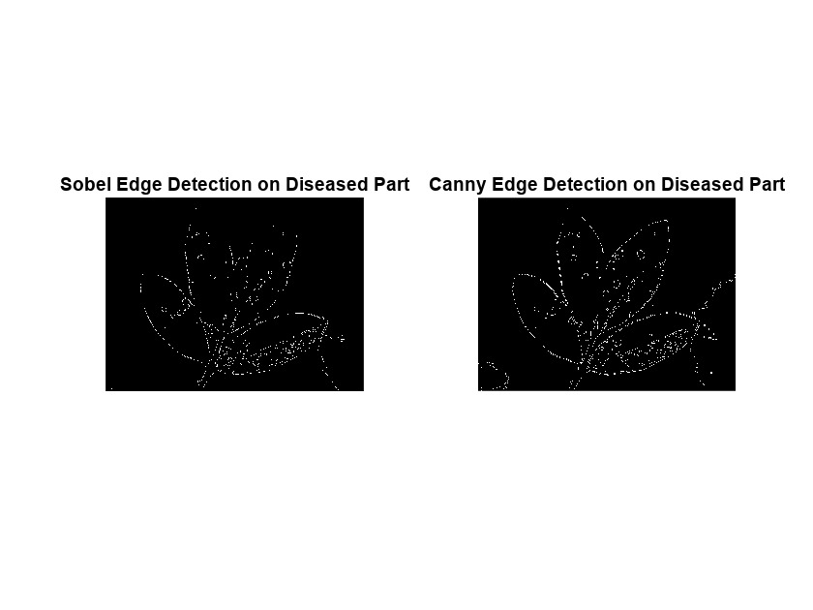











Implementation and Results – Iteration 1
OTSUS METHOD
Groundnut Leaf-Bacterial Leaf Spot
a)
b)
c)
d)
e)
Fig-1:a)Original image of Groundnut leaf b)Contrast-adjusted image c)Binary mask of diseased part of Leaf Bacterial spot c)Separated diseased part with white background using Otsu Method d)Sobel and canny edge detection
Chilli Leaf-Bacterial Leaf Spot
a)
b)
c)
d)
e)
Fig-2:a)Original image of Chilli leaf b)Contrast-adjusted image c)Binary mask of diseased part of Leaf Bacterial spot c)Separated diseased part with white background using Otsu Method d)Sobel and canny edge detection
Carrot Leaf-Blight
a)
b)
c)
d)
e)
Fig-3:a)Original image of Carrot leaf b)Contrast-adjusted image c)Binary mask of diseased part of Leaf Blight c)Separated diseased part with white background using Otsu Method d)Sobel and canny edge detection

Slide 42














K-MEANS METHOD
Groundnut-Bacterial Leaf Spot
a)
b)
c)
d)
e)
Fig-4:a)Original image of Groundnut leaf b)Contrast-adjusted image c)Binary mask of diseased part of Leaf Bacterial spot c)Separated diseased part with white background using K-mean Method d)Sobel and canny edge detection
Chilli Leaf-Bacterial Leaf Spot
a)
b)
c)
d)
e)
Fig-5:a)Original image of Chilli leaf b)Contrast-adjusted image c)Binary mask of diseased part of Leaf Bacterial spot c)Separated diseased part with white background using K-mean Method d)Sobel and canny edge detection
Carrot Leaf-Blight
a)
b)
c)
d)
e)
Fig-6:a)Original image of Carrot leaf b)Contrast-adjusted image c)Binary mask of diseased part of Leaf Blight c)Separated diseased part with white background using K-mean Method d)Sobel and canny edge detection

Slide 43
Contribution
Team Progress and Movement
Our team efficiently worked step by step from scratch, implementing Sobel and Canny edge detection techniques using MATLAB, enhancing image quality, segmenting diseased areas through K-means clustering and Otsu’s thresholding, and collaboratively refining our methods to develop a comprehensive plant disease detection system.
Individual Contribution
Key contributions: S.SAMEERA TASNEEM
Led the image preprocessing phase, focusing on enhancing image contrast and converting RGB images to grayscale. Developed the initial Otsu's thresholding method to detect diseased areas in plant leaves.
Key contributions: SARAI SAI LOHITHA
Focused on implementing K-means clustering for effective segmentation of the diseased parts of the plant images. They analyzed the performance of both Otsu’s and K-means methods to determine the most effective approach for disease detection.
Key contributions: RAMIREDDY INDUMATHI
Concentrated on edge detection techniques, specifically the Sobel and Canny methods. They integrated the edge detection results into the overall analysis of plant health, providing critical insights for the final report.

Slide 44

Conclusion & Future Work
Summary and Conclusion
This project aimed to detect plant diseases through image processing in MATLAB. It involved enhancing tomato leaf images, applying Otsu's method and K-means clustering for segmentation, and using Sobel and Canny edge detection to identify diseased areas. The results showed effective differentiation between healthy and diseased regions, validating the approach and providing insights for future enhancements.
Future Work
In the next phase, we plan to implement the image processing techniques developed, specifically Otsu’s and K-means methods for plant disease detection, on the Zynq 7000 SoC using Vivado. This will enable real-time data processing directly on the device, enhancing the efficiency of disease detection in agricultural applications. We will also optimize the algorithms for better performance and explore additional machine learning techniques to improve the accuracy and robustness of our system.

Slide 45

THANK YOU

